Slide 1
Food Engine

Slide 2
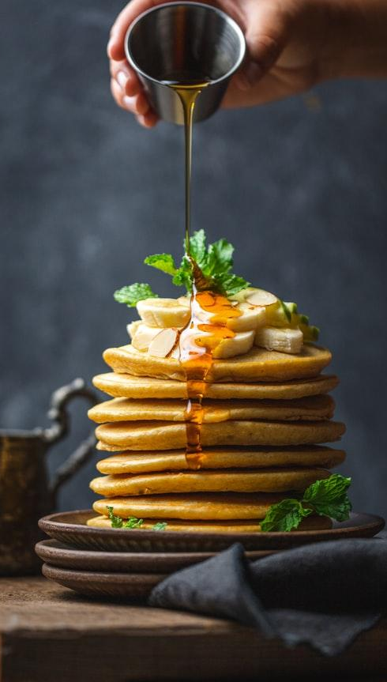
Overview
Team Members
Aditya Ashtekar - ama1219
Palak Shah - pvs276
Sabarni Kundu - sk7970
Vishaal Ranjan - vr1089
Professor:
Sambit Sahu

Slide 3

Goal!
Food Delivery Web Application that takes care of your nutrition needs and delivers your food to your doorstep.

Slide 4
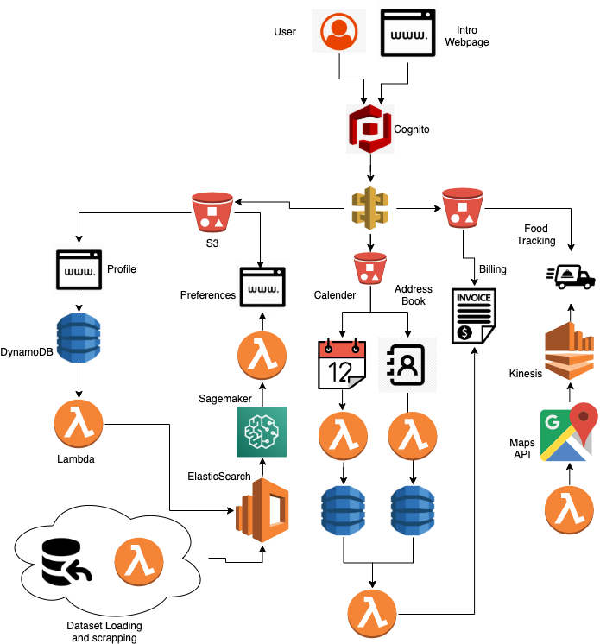
Architecture

Slide 5

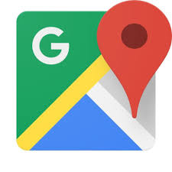







Services Used
Amazon S3
Cognito
Google Maps API
Sagemaker
Kinesis
Lambda
API Gateway
Elastic Search
DynamoDB

Slide 6
Sign In and Sign Up
1
Users will create an account and Sign In.

Slide 7
Here the user will sign up a new account if it does not have any existing account or sign in using the existing username and password.
We have used Cognito to provide security for our application and authentication for our users.

Slide 8
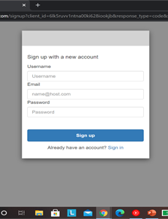
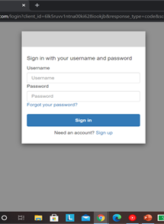
Sign in and Sign up
The image shows the how the user can create an account and sign in.

Slide 9
Profile
2
After Sign-in the user will be directed to the profile page

Slide 10
User will fill up their details and build up their profile.
Based on their height and weight the system calculates the BMI
User will also mention their dietary restrictions and allergies if they have.
This data is stored in DynamoDB

Slide 11
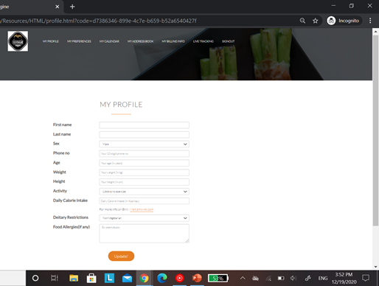
Profile Page
Image shows how the user needs to fill up their details.

Slide 12
Preferences
3
Once the user updates the profile, they will be redirected to the preferences page.

Slide 13
We have used Sagemaker and Elastic search for the recommendations.
For each day user will be getting different options and then update their preferences.
You can get new recommendations by clicking get new recommendations.

Slide 14
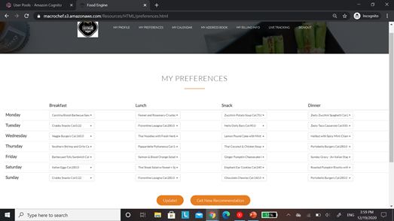
Preferences Page
The image shows how the preferences are generated for the user.

Slide 15
Calendar
4
Once the user updates their preferences they are redirected to the calendar page.

Slide 16
The calendar page shows the time when the user needs to eat their meal. You can adjust the timing by sliding in the calendar.
Calendar can be viewed weekly, monthly or daily.
We have used lambda to update the calendar.

Slide 17
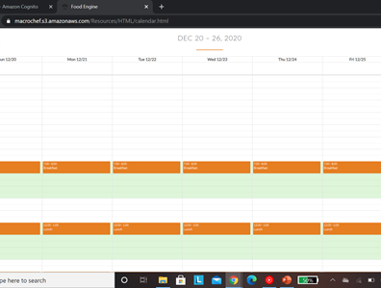
Calendar Page
The image shows how the calendar looks.

Slide 18
Address Book
5
Once the calendar is updated user will be redirected to address book.

Slide 19
Once the calendar is updated user will enter their address for each of their meal.
This is the address needed for the delivery of the meal.
This address will be further stored in the Dynamodb.

Slide 20
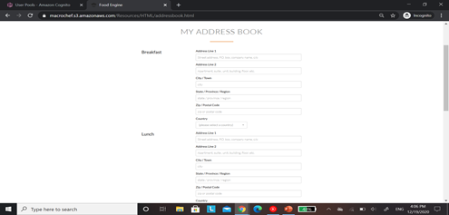
Address Book Page
The image shows how the user will enter the address for their meal delivery.

Slide 21
Billing Info
6
User will now provide billing information

Slide 22
User will now get the customized meal plan and the payment for the same.
The user will enter their card details that will be further stored in the DynamoDB.

Slide 23
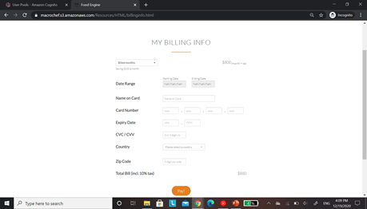
Billing Info Page
The image shows how the user will enter their billing information.

Slide 24
Live Tracking
7
Once the User click on live tracking tab, they can track their meal.

Slide 25
User can track their meal and get an idea about how far the meal is from the destination.
User can select the meal type and they can know where their meal is.
We have integrated google API Maps to our system.

Slide 26
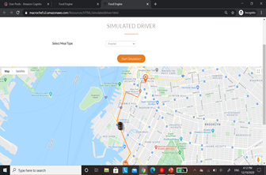
Live Tracking Page
The image shows how the user can track their meal.

Slide 27
Thank You

